Slide 1

Can you explain the price of Electricity – by QRT
Talha Jamal, Chenghu Lyu, Yiru Wang, Krzysztof Plachta, Xinyue Wang

Slide 2
Challenge: Modeling Electricity Futures Prices
Challenge context:
Energy trading is an increasingly competitive area which is why Qube Research & Technologies made a challenge to model electricity prices
Electricity prices are very complex to model as they are influenced by multitude of factors
They are influenced by: energy mix in a given country, weather, commodities prices, etc.
Additionaly electricity is also traded across borders
Challenge goals:
The goal is to explain what influences electricity prices; it’s not purely a price prediction problem
This needs to be achieved using provided data about prices of electricity futures in Germany and France
The benchmark score is set by a simple linear regression
The goal is to beat the benchmark of 15.86% and set the highest score!
Evaluation is based on Spearman's correlation between the estimated output and the actual daily price changes over the testing data set sample

Slide 3
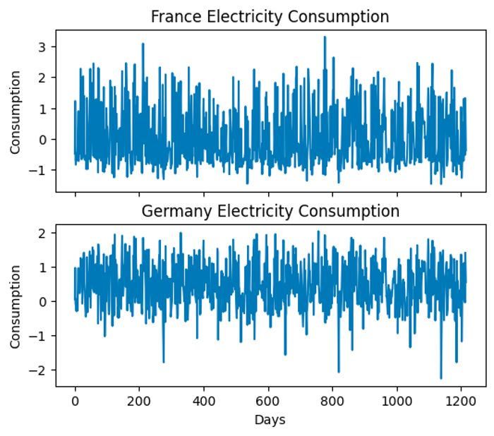
Dataset
Overview
Daily price variation of Futures
33 Features Provided including:
Commodity price variation (gas, coal, carbon)
Weather data (temperaturę, rainfall, wind)
Daily energy production within country by source (gas, coal, hydro, nuclear, wind, lignite)
Usage metrics (consumption, import/export volume.)
Issues
Data was missing for some days
Data was indexed by day id; dates not provided
Solutions
We interpolated missing data using a polynomial function to account for non-linearity
Removed information with no predictive power e.g. removing the column for Day ID

Slide 4
Supervised and Unsupervised Machine Learning Models
Model | Model overview | Benefits | Drawbacks
Lasso | Linear regression plus L1 regularisation penalty term | Ability to shrink coefficients to 0 Easy to adjust factor forms and interpret results | Assuming mostly linear functional forms in-sample
Ridge | Linear regression plus L2 regularisation penalty term | Ablility to relieve collinearity Easy to adjust factor forms and interpret results | Assuming mostly linear functional forms
Random Forest | Fits a number of decision tree regressors on various sub-samples of the dataset and uses averaging to improve the predictive accuracy and control over-fitting | High accuracy Reduced overfitting Assigns a score to each feature based on its contribution to the model's performance. | Long training time Resource-intensive
XGBoost | Utilises an ensemble of decision trees, sequentially correcting previous errors, to accurately predict continuous outcomes by minimizing a specified loss function | Fast Algorithm High Flexibility Able to tackle large datasets efficiently | Prone to overfitting if hyper parameters are not cross validated
LightGBM | Advanced gradient boosting framework that uses Gradient-based One-Side Sampling technique to filter out data instances efficiently during training process and supports various advanced features like parallel and GPU learning | High performance, fast speed Reduced memory usage and overfitting Scalability in real-world applications Good with large datasets | Time-consuming to tune the hyperparameters Difficult to interpret
Feedforward Neural Network | Neural Network model consisting of input, hidden and output layers. Each layer consist a number of nodes, which are connected to adjacent layers with weights. In FNN, the connections don’t form cycles, the data only moves forward | Can automatically learn relevant features from raw data Can handle large datasets and be scaled to more complex architectures with additional layers and neurons. | Complex model can be very computationally expensive Has many hyperparameters, thus tuning for the right combination can take long

Slide 5
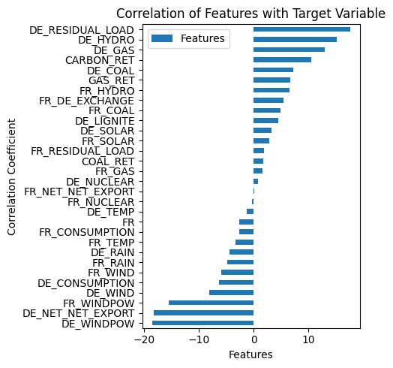
Feature engineering
Correlation of Features with Target Variable
Trying to catch non-linear patterns: Squared Variables of Features
Categorical Variable for Country Column
Removing perfectly colinear features: France and Germany exchanging electricity and vice versa.

Slide 6
Grid Search Optimization of Parameters via Cross Validation
Grid search optimization process
⁠During Grid Search, a 5-fold cross validation is employed to split the training data into 5 subsets, with each subset getting a chance to be the validation set while the other 4 subsets form the training set. This ensures the model is robust and not overfitted
⁠The loss function to optimize over here is the Mean Squared Error.
4⁠
1
Exhaustive Search over a specified parameter grid to tune multiple hyperparameters
2
3
The Model is evaluated by calculating the MSE and Spearman Correlation via its prediction on the test dataset that it has not yet seen.

Slide 7
In Sample & Out of SampleAnalysis: All ML Models outperformed the Benchmark
Comments
It was important to not overfit the model, Ridge and Lasso achieved highest in-sample correlation but did poorly out of sample
Our LightGBM is located in top 10% in this competition, and all the models are beat the benchmark model (Out of Sample Correlation: 15.7 %)
Model | MSE | In Sample Correlation | Out of Sample Correlation | Rank /866
LightGBM | 1.0474 | 14.91% | 27.49% | 77
Feedforward Neural Network | 1.0618 | 12.12% | 23.45% | 231
XGBoost | 0.9886 | 14.86% | 21.88% | 340
Random Forest | 0.7106 | 9.6% | 19.40% | 534
Lasso | 0.8622 | 18.05% | 16.49% | 692
Ridge | 0.9130 | 16.11% | 16.08% | 711

Slide 8
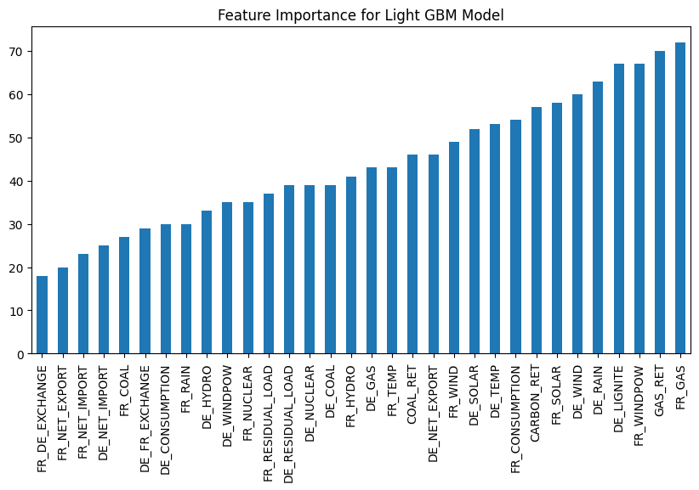
Our best model – LightGBM considered gas to be the main determinant of electricity price
Motivated by environmentally friendly action, the main source of generating electricity is from the gas, wind power and other renewable energy source, so gas price have the most impact on electricity price mostly, followed by renewables such as wind power and rain.
The demand and supply of electricity within these two countries are balance, so the international trade factors (exchange, their imports and exports) have least impact on electricity prices, which indicates that does not affect electricity prices much.

Slide 9
Conclusion
The Changes in Electricity Prices are extremely volatile: Linear Models do not capture the non-linear movements well enough to have predictive power out of sample.
Gradient Boosting Tree Models coupled with efficient and in-depth cross validation prevent overfitting and perform well out of sample.
Non-Linear Movement of Target Variable – Employ Deep Learning Techniques to capture the non-linearity that our existing models were not able to capture.
QRT – Electricity Price Prediction Challenge: https://challengedata.ens.fr/participants/challenges/97/ranking/public
Ranking | Date | User(s) | Public score
1 | Sept. 13, 2023, 8:03 p.m. | BenAmara.MohamedAli | 0.6083
2 | Feb. 22, 2024, 4:36 p.m. | emmanuel2024 | 0.5507
75 | Dec. 12, 2023, 10:04 a.m. | erk123 | 0.2761
77 | Feb. 25, 2024, 1:23 a.m. | Imperial College London – Big Data Group 3 | 0.2749
80 | April 5, 2023, 4:37 p.m. | DD | 0.2743

